Slide 1



Ashley Cramer, Additive Manufacturing Institute,
The IDEAL Center for Innovation
Barker Carlock (Class of ’17), Chemical and Biomolecular Engineering
The Power of
Printing
in Social Justice

Slide 2
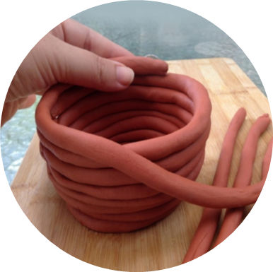
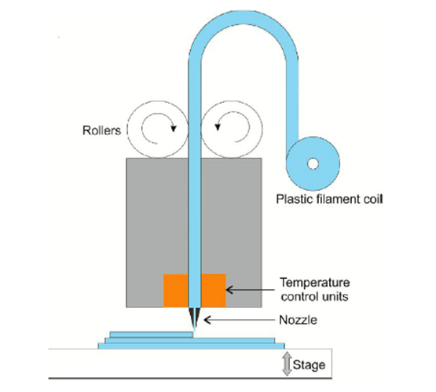
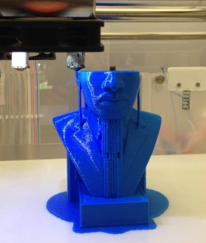
How does it work?
Fused Filament Fabrication
Notes:
Visual aid of post its to show layer by layer

Slide 3
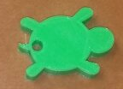

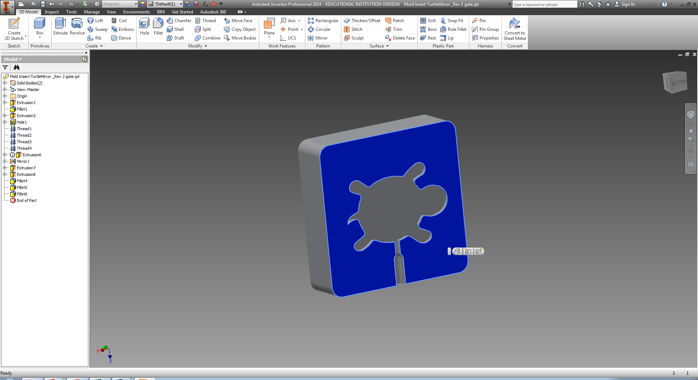
Why 3D Print?
Models help validate ideas:
Physical models are much more helpful than drawings and renderings for understanding
Materials
Digital

Slide 4


Break into Groups
Find and print one object that relates to social justice and the Big 8 (age, ability, ethnicity, gender, race, religion, sexual orientation, socioeconomic status).
Scale the print so the estimated time is less than 40 minutes.

Slide 5
What do you see as the power of 3D printing?
Notes:
4th dimension of 3D printing is leveraging these technologies to produce good/change in the world…use empathy to identify it

Slide 6

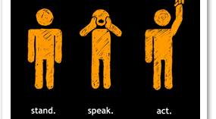

Leveling the Playing Field
Notes:
First, the explosion in cheap and powerful prototyping tools, which have become easier to use by non-engineers. And second, the economic crisis has triggered an extraordinary shift in the business practices of (mostly) Chinese factories, which have become increasingly flexible, Web-centric, and open to custom work (where the volumes are lower but the margins higher)

Slide 7
Leveling the Playing Field
Low barrier to entry
Flexibility to new system compared to old ones
Democratizing, empowering, and profitable
Manufacturing open to more people --Supply chains open to small guy
  Can design and sell goods without infrastructure or inventory
  Hardware is becoming like software
    Common platforms, easy to use tools, Web-based collaboration, and internet distribution
Notes:
First, the explosion in cheap and powerful prototyping tools, which have become easier to use by non-engineers. And second, the economic crisis has triggered an extraordinary shift in the business practices of (mostly) Chinese factories, which have become increasingly flexible, Web-centric, and open to custom work (where the volumes are lower but the margins higher)

Slide 8
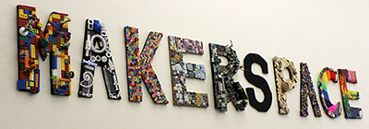
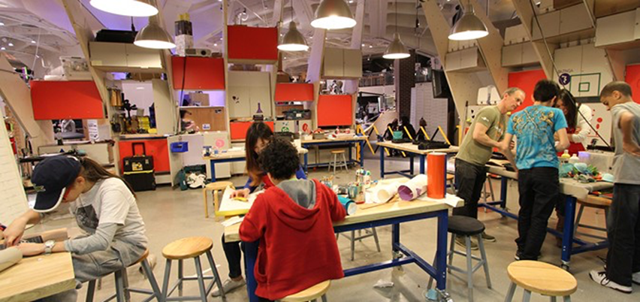
The Movement
Experiential Learning
Notes:
Where the

Slide 9
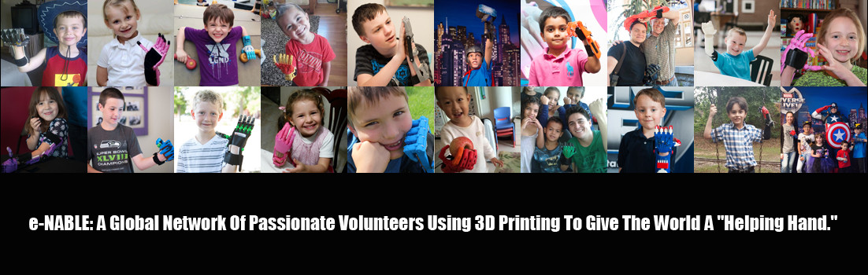
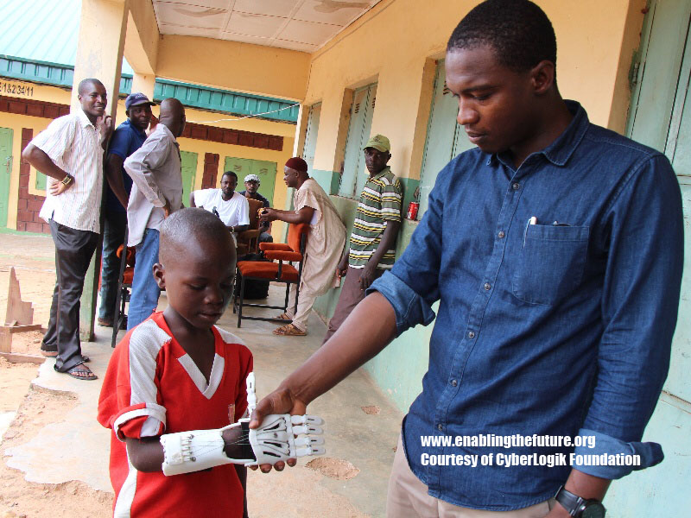

Case Study: The Power of Printing a Helping Hand

Slide 10
What are the dangers of 3D printing?
Notes:
4th dimension of 3D printing is leveraging these technologies to produce good/change in the world…use empathy to identify it

Slide 11
Dangers of Individualization
Individualistic
Materialistic
Instant gratification
Design around political, legal, and economic system
Decentralization
Need to determine real potential of “making”

Slide 12
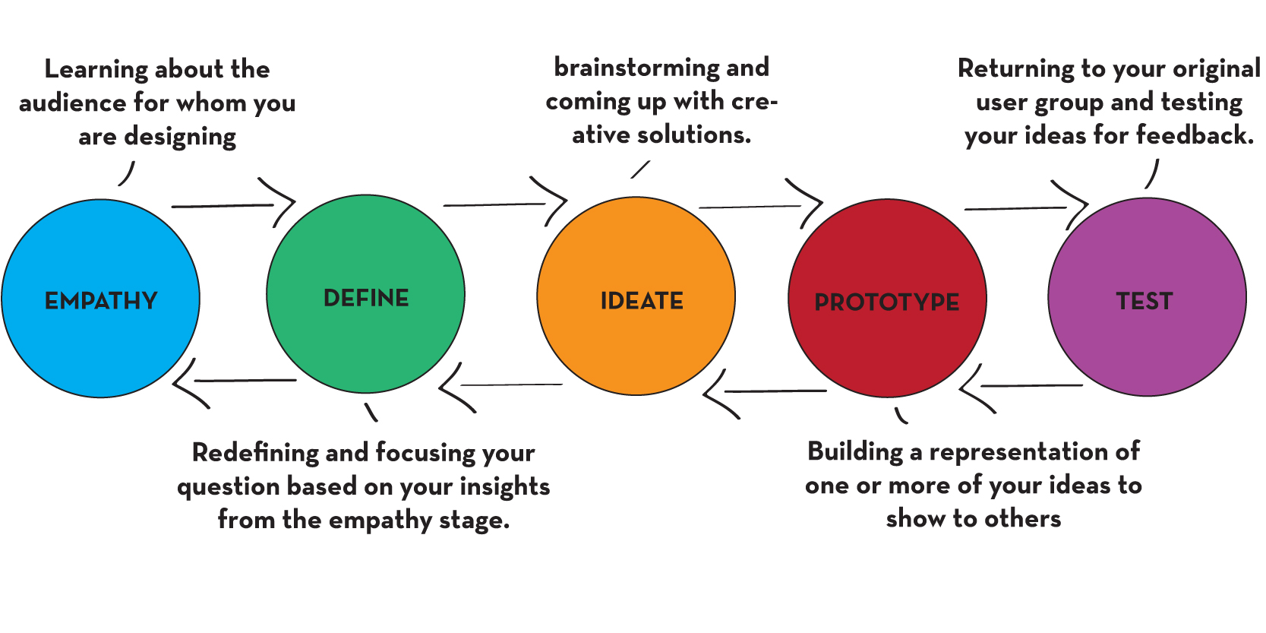
How to solve problems of the 21st Century?
3D problems require 4D technical thinking
Design thinking
Notes:
4th dimension of 3D printing is leveraging these technologies to produce good/change in the world…use empathy to identify it

Slide 13
What do you see as the role of STEM fields in social justice?
Notes:
4th dimension of 3D printing is leveraging these technologies to produce good/change in the world…use empathy to identify it

Slide 14
Diversity in STEM (Science, Technology, Engineering, and Math)
What is the percentage of underrepresented populations in STEM fields?
27%
usnews.com/esa.doc.gov

Slide 15
Diversity in STEM (Science, Technology, Engineering, and Math)

Slide 17
Diversity in STEM (Science, Technology, Engineering, and Math)
Whites and Asians make up (2014)
  87% of the engineering workforce
  84% of the computing workforce
  83% of the advanced manufacturing workforce
Percent of minorities and women in these fields have essentially remained static since 2001
86% of engineers and 74% of computer professionals are men
CTEq analysis of U.S. Census Bureau report on STEM college graduates, 2014.
Change the Equation. The Diversity Dilemma. 2015

Slide 18
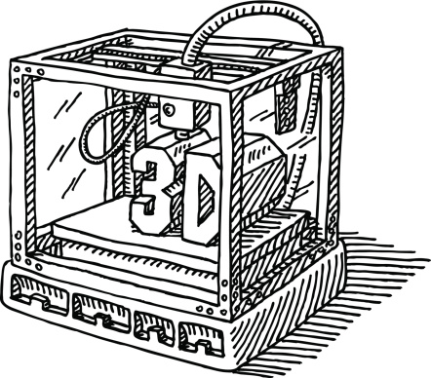
Be a 4D Changent Using
3D Technologies
Notes:
3D printing is the tool to break down the disproportionate demographics in STEM to solve grand challenges of our future.

Slide 19


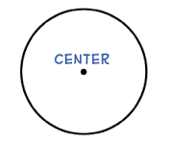

Thank you

